Slide 1
MSDS670 Data Visualization Mid Term Assignment
Erin Kane
28 May 2023

Slide 2


Situation: Purchasing a new AVON treadmill. AVON treadmills offer a basic, intermediate, and high-performance models. This is a real case scenario of personal best practices when looking to invest in new exercise equipment for home gym. This particular dataset, CardioGoodFitness decides to analyze data from treadmill purchases at its retail stores in the last three months. The team identifies the following customer variables to study

Slide 3
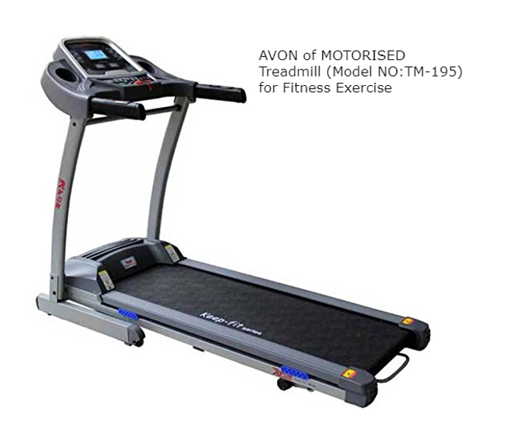
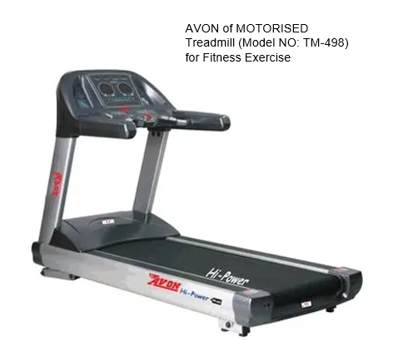
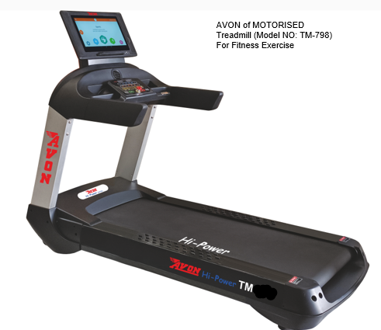
Research Question: Investigating data for the best-in-class AVON Treadmill between their basic model TM195, intermediate TM498, and High Performance TM798, for Age range, Income, and Fitness level.

Slide 4




Data: Utilizing the CardioGoodFitness dataset from Kaggle.com 180 rows, 9 columns. No missing values.
Feature: | Possible Values
Product: | TM195, TM498, TM798
Gender: | Male, Female
Age: | In years from 18-50
Education: | In years
Marital Status: | Single or Patnered
Income: | Annual income in $
Miles: | Average number of miles the consumer expects to walk or run each week
Fitness Level: | Self-rated fitness level on scale 1-5, where 1 is poor shape, and 5 is excellent shape.

Slide 5
Methodology
First, I gathered all the data, made sure that there were no missing values.
I broke out my visuals based upon the three different models.
I was looking at Gender, Age, Fitness Level, and Average Annual Income. I thought using these factors would provide a good idea into the typical buyer for those categories to leverage where I would categorize myself.
I evaluated data with Excel, using pivot tables.

Slide 6
Results
$75K per year opted for the high-performance model.
$46 -$49K per year are split between the base and the intermediate model.
~$30K per year difference between those who bought the base/intermediate vs. high-performance models

Slide 7
Results
Intermediate, Fitness Level 3, shows an abundant number of buyers in both the low and mid tier class treadmill
Fitness Level 5 indicates that the lowest tier and the highest tier treadmill purchased.
The value, according to Level 3 users, is purchased atF the lowest tier.

Slide 8
Results
Female and Male buyers were evenly proportioned with the base model.
The Base Model, TM195, swept the competition with 40 more sold than the middle tier.
33 Males purchased the high-performance model, while only 7 females did.
Age Range 33-40 (my age range) were similar in number.

Slide 9
Conclusion
After investigating data for the best-in-class AVON Treadmill between their basic model TM195, intermediate TM498, and High Performance TM798, for Age range, Income, and Fitness level; I have concluded that most purchased at my fitness level, age range, and income level. I would be best suited for the TM798 model.
The high-performance model will best suit my needs now and as I continue to grow from using the product.

